Slide 1
FINANCIAL SOUNDNESS ANALYSIS: Global Banking Stability & Risk
A Country-wise Evaluation of Key Financial Health Indicators (2007–2024)

Slide 2
Project Roadmap
Introduction
Project Overview & Objective
Key Indicators & Methodology
Country-wise Analysis (Graphs + Insights)
Summary of Trends
Conclusion & Recommendations

Slide 3
PROJECT OVERVIEW & OBJECTIVES
.
This project explores the financial stability of major global economies by analyzing key indicators from the IMF Financial Soundness Indicators (FSI) dataset. The focus is on identifying systemic risks, capital adequacy, and liquidity patterns from 2007 to 2024
Objectives:
Analyze long-term trends in NPLs, ROA, Tier 1 Capital, and Liquidity
Generate actionable insights from temporal data
Enhance risk analysis skills relevant to regulatory reporting and financial analytics

Slide 4
Key Indicators & Methodology
Key Indicators
Non-performing Loans to Total Gross Loans (%) (Asset Quality – Credit Risk)
Return on Assets (ROA) (%) (Profitability Indicator)
NPL Net of Provisions to Capital (%) (Capital Adequacy – Risk Absorption)
Tier 1 Capital to Risk-Weighted Assets (%) (Basel III – Core Capital Strength)
Liquid Assets to Short Term Liabilities (%) (Liquidity – Short-term Resilience)
Net Open Position in FX to Capital (%) (Market Risk Exposure – Currency Risk)
Methodology
Data Source: IMF Financial Soundness Indicators (FSI)
Countries Selected: Brazil, France, Germany, Japan
Period Considered: 2008–2024
Tools Used: Python (Pandas, Matplotlib/Seaborn), Jupyter Notebook (Optional dashboard under development using Power BI for interactive monitoring)
Steps Followed:
Imported and cleaned data
Filtered for relevant countries and indicators
Visualized indicator trends using line plots and subplots
Focused on understanding macro-level risk trends
*Indicators selected are consistent with Basel III regulatory focus areas including capital adequacy, credit risk, and market liquidity.

Slide 5
Country-wise Analysis (Graphs + Insights)

Slide 6
E Country-wise Analysis (Graphs + Insights) Country-wise Analysis (Graphs + Insights) Country-wise Analysis (Graphs + Insights) Country-wise Analysis (Graphs + Insights)
BRAZIL

Slide 7
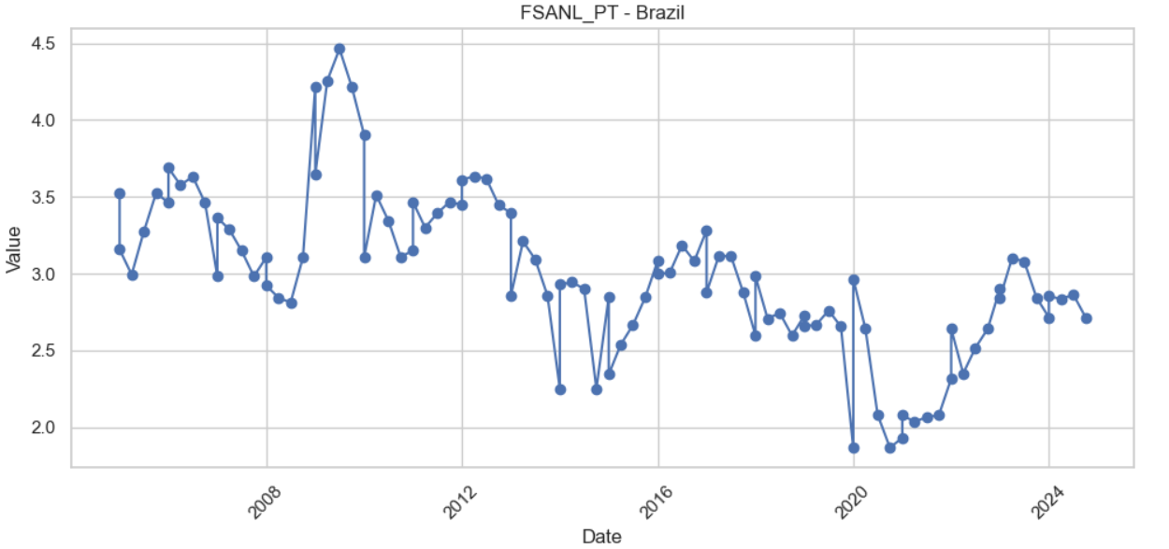
Brazil – Non-performing Loans to Total Gross Loans (%) (2007–2024)
Key Insights :
Volatile NPL levels between 2007 and 2011, with a peak around 2009–2010, possibly linked to global financial instability.
A gradual decline from 2012 to 2019, suggesting improved credit quality and stricter lending practices.
Sharp dip around 2020, likely due to COVID-era financial reliefs and moratoriums reducing visible defaults temporarily.
A post-pandemic rise until 2022, reflecting delayed recognition of stressed loans.
Slight stabilization post-2023, indicating potential economic recovery or better NPL management.

Slide 8
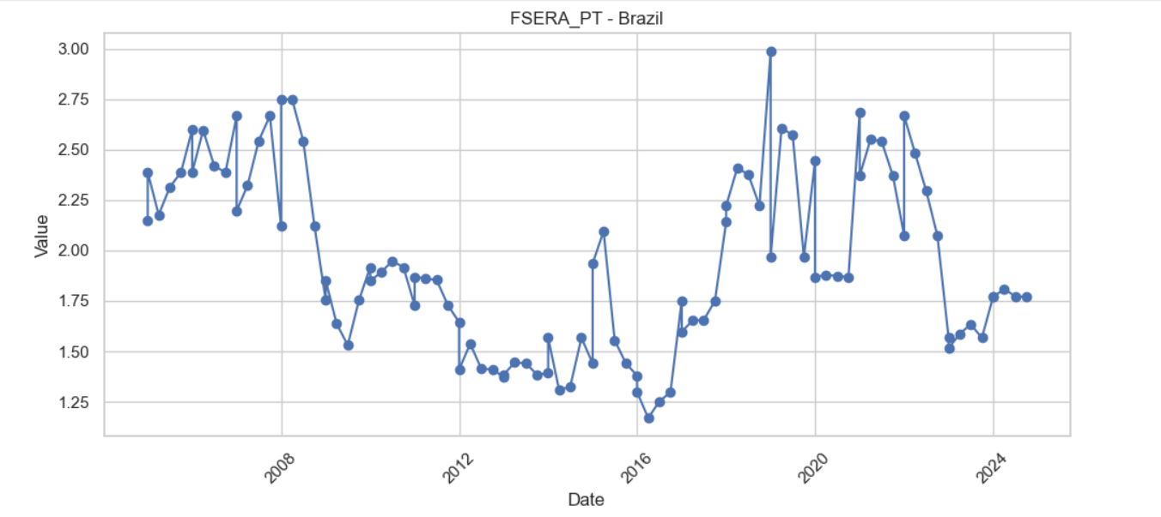
Brazil – Return on Assets (ROA) (2005–2024)
Key Insights:
2005–2008: ROA values remained relatively strong and stable, indicating consistent profitability.
2009–2011 dip: Reflects the lagging effects of the global financial crisis, possibly due to shrinking margins and higher provisioning.
2012–2016 stagnation: Persistent low ROA suggests a challenging profitability environment, possibly due to stricter regulations or economic slowdown.
2017–2020 surge: A notable recovery in ROA, suggesting improved asset efficiency and stronger bank performance.
Sharp volatility during 2020–2022: Likely due to COVID-19 disruptions, fluctuating operational costs, and policy support.
2023 drop and stabilization: Indicates normalization post-pandemic and possibly more conservative lending or lower margins.

Slide 9
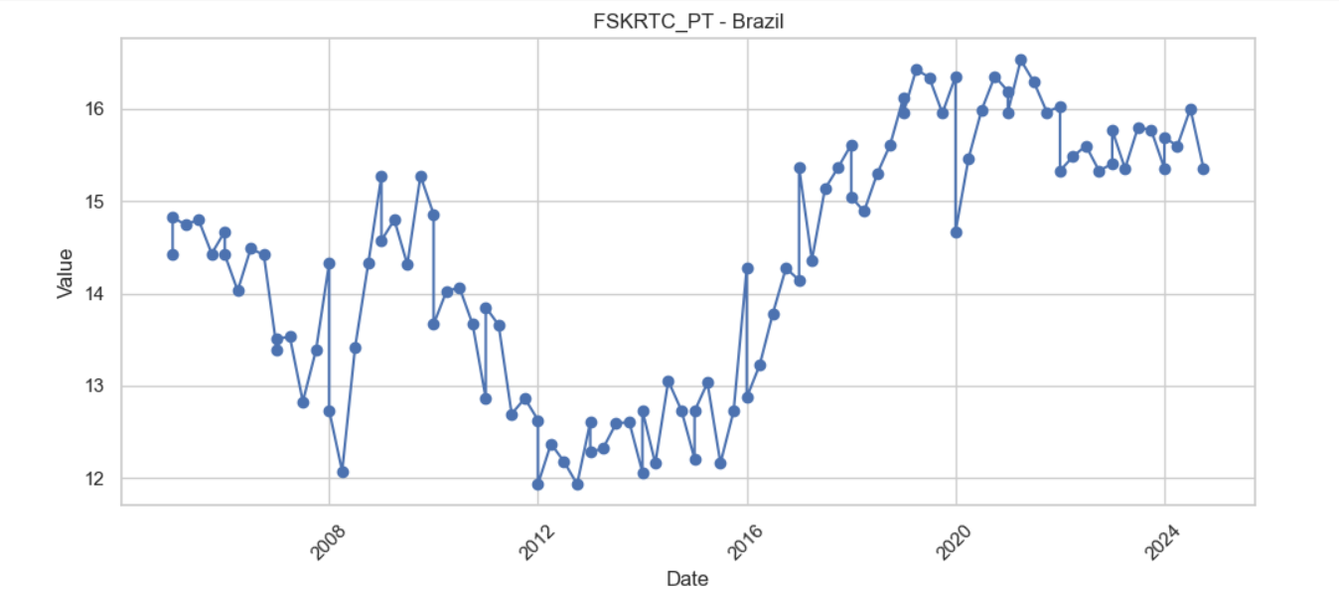
Brazil –Tier 1 Capital Adequacy Trend (2005–2024)
Key Insights:
2005–2012 Decline:
A steady decline in capital adequacy from ~14.8% to ~12%, suggesting weakened capital buffers.
Likely influenced by global financial crisis effects and tighter profitability reducing retained earnings.
2013–2016 Plateau:
Stabilized capital ratios indicate a slow recovery period, possibly due to conservative capital retention strategies.
Post-2016 Surge:
Sharp rise up to ~16% by 2019–2021 suggests regulatory tightening (Basel III) and strengthened capital requirements.
Could also reflect better earnings retention and reduction in risky assets.
Post-2021 Stability:
Ratios stabilized around 15.5–16%, indicating a well-capitalized banking sector, aligned with global regulatory expectations.

Slide 10
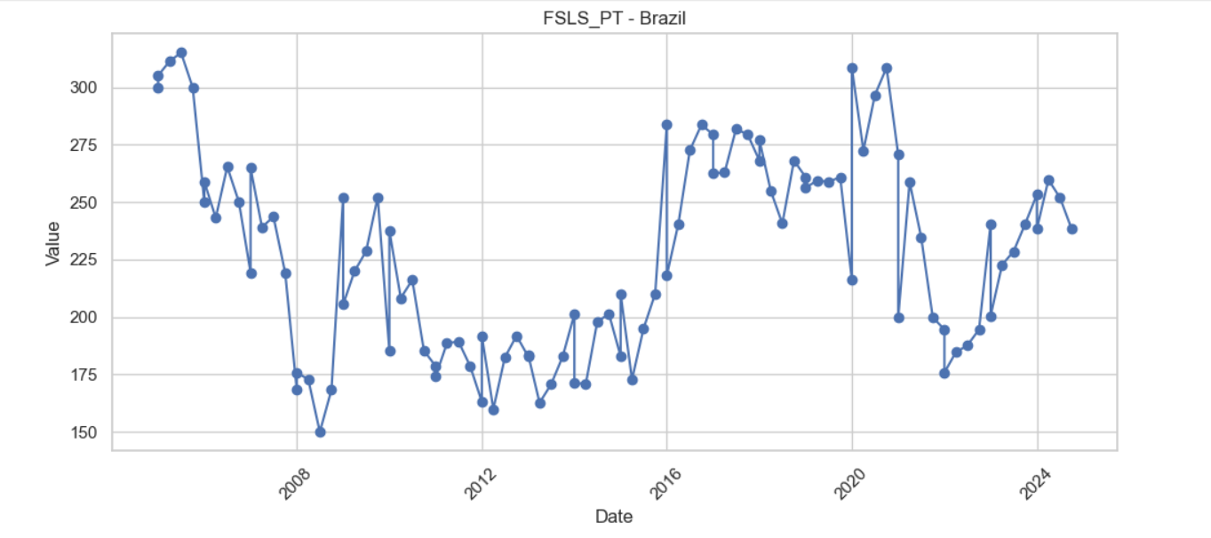
Brazil – Liquidity Ratio Trend (2005–2024)
Key Insights:
Sharp decline from 2005 to 2009, indicating reduced short-term liquidity, possibly due to pre-global financial crisis vulnerabilities.
Stabilization and moderate rise between 2010 and 2015, suggesting recovery efforts and improved liquidity management.
Significant surge in 2016–2019, possibly due to conservative banking policies, higher liquid reserves, or regulatory tightening.
Dip during 2020–2021, likely tied to COVID-19 pressures and the need to draw down liquid assets to meet obligations.
Recovery from 2022 onwards, reflecting economic rebound and banks replenishing liquid buffers.

Slide 11
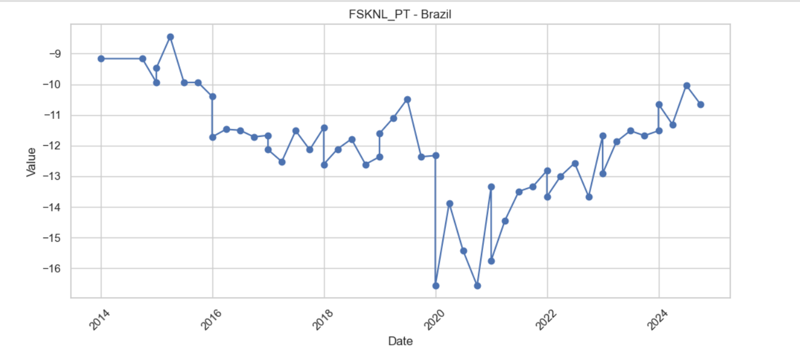
Brazil – Non-performing Loans Net of Provisions to Capital(%)
Key Insights:
Stable credit risk exposure from 2014 to 2018, ranging between -9% and -12%, indicating consistent provisioning relative to NPLs.
Noticeable deterioration in 2019–2020, likely due to rising defaults and pandemic-related stress, with a sharp dip to around -16.5%.
Recovery begins post-2021, reflecting improved loan performance or reduced provisioning needs, gradually returning to pre-COVID levels.
Persistent volatility suggests ongoing sensitivity to macroeconomic shifts and adjustments in risk management strategies.
Values remain negative, indicating provisions still exceed NPLs—a sign of cautious banking practices but also a potential buffer against future shocks.

Slide 12
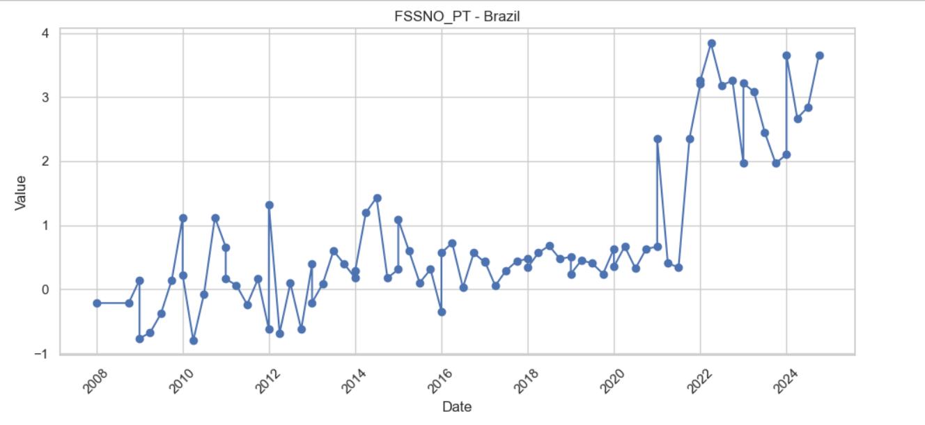
Brazil Foreign Exchange Exposure to Capital (2008–2024)
Key Insights:
FX exposure remained low and volatile between 2008 and 2020, mostly fluctuating around 0%, suggesting minimal net currency positions.
A sharp rise is observed starting 2021, peaking close to 4%, indicating a significant increase in foreign exchange exposure relative to capital.
The post-2021 spike likely reflects greater currency mismatches, possibly due to increased foreign borrowing or valuation effects amid global volatility.
Exposure stays elevated through 2024, implying persistent FX-related risks in the banking system.
This shift highlights the need for enhanced FX risk management and hedging, especially under potential currency depreciation scenarios.

Slide 13
Summary of Trends
Indicator | Trend Summary
Non-Performing Loans to Total Gross Loans (%) | Volatile 2007–2011; decline through 2019; sharp 2020 dip (COVID relief); rebound in 2021–2022; stabilizing in 2023–2024.
Return on Assets (ROA) | Strong 2005–2008; dip post-GFC; stagnant 2012–2016; strong recovery 2017–2020; COVID-driven volatility; stable post-2023.
Tier 1 Capital Adequacy | Decline (2005–2012); flat 2013–2016; surge post-2017 (Basel III effects); stable at ~15.5–16% after 2021.
Liquidity Ratio | Sharp drop until 2009; gradual rise to 2015; surge 2016–2019 (regulatory tightening); dip during COVID; recovering post-2022.
NPLs Net of Provisions to Capital (%) | Stable negative (2014–2018); worsened in 2019–2020; recovery after 2021; values remain negative, signaling cautious provisioning.
FX Exposure to Capital | Low and stable (~0%) until 2020; sharp rise post-2021 (~4%); persistent risk through 2024, highlighting FX sensitivity.

Slide 14
Overall Themes
Pre-2012: Stress from global financial crisis; capital and liquidity under pressure.
2013–2019: Recovery phase; improved risk buffers and profitability.
2020–2022: COVID disruptions; liquidity strain, asset quality issues, FX volatility.
2023–2024: Signs of stabilization across most indicators but emerging FX risks remain.

Slide 15

E Country-wise Analysis (Graphs + Insights) Country-wise Analysis (Graphs + Insights) Country-wise Analysis (Graphs + Insights) Country-wise Analysis (Graphs + Insights)
GERMANY

Slide 16
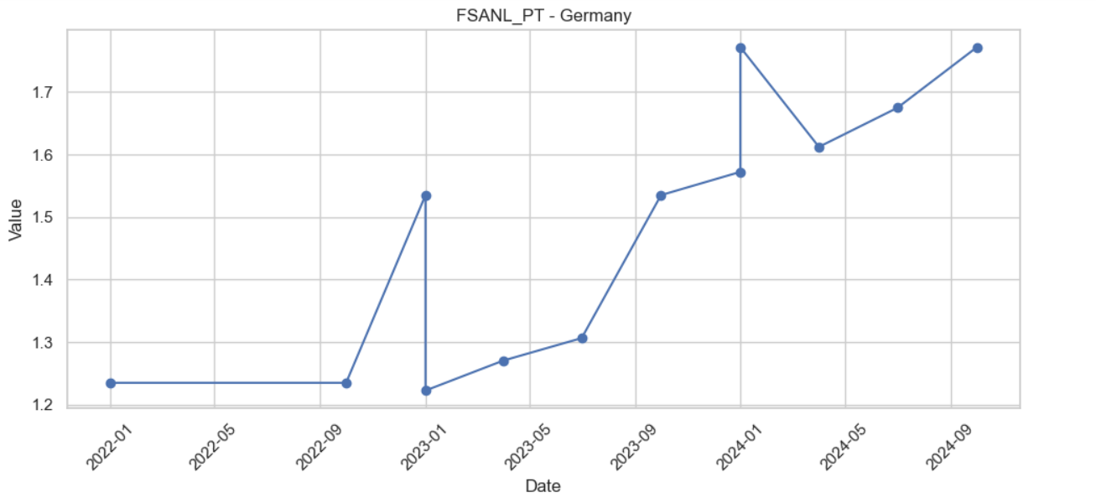
GERMANY – Non-performing Loans to Total Gross Loans (%) (2022–2024)
Key Insights :
Non-performing loan (NPL) ratios remained stable at ~1.24% throughout 2022, suggesting a healthy loan book.
A sharp rise in early 2023 indicates emerging credit stress, potentially linked to macroeconomic tightening or sector-specific pressures.
Steady upward trend continues through 2024, reaching around 1.75%, signaling a gradual deterioration in asset quality.
The persistent increase may reflect challenges in borrower repayment capacity or delayed effects of rising interest rates.
Rising NPLs highlight the need for proactive risk monitoring and stronger credit management by financial institutions.

Slide 17
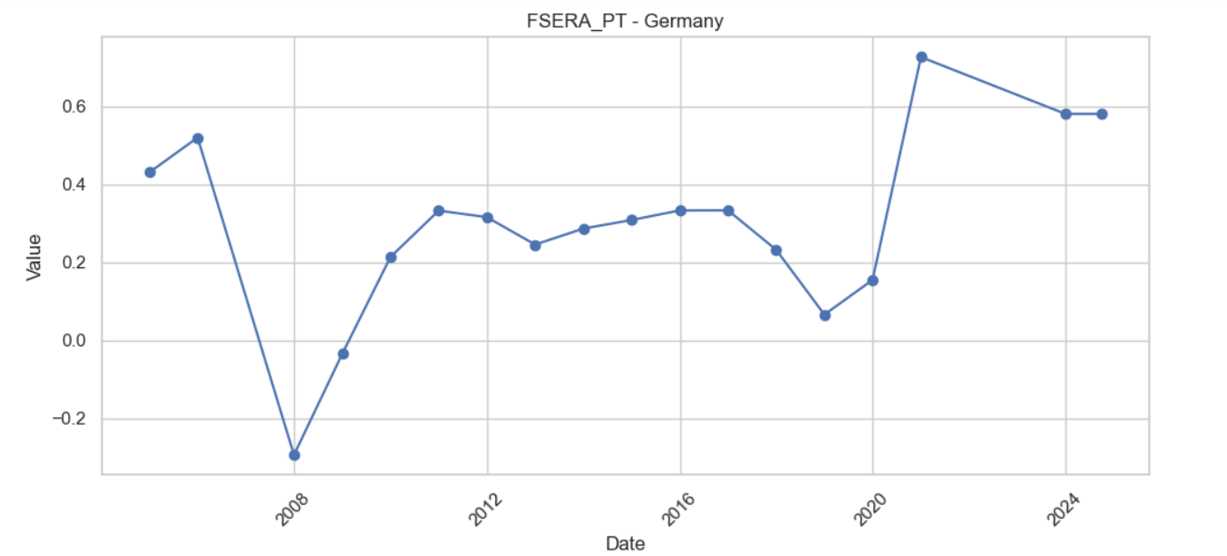
GERMANY – Return on Assets (ROA) (2005–2024)
Key Insights:
ROA declined sharply during the 2008 global financial crisis, turning negative, reflecting severe profitability stress.
A gradual recovery followed between 2009 and 2016, with ROA stabilizing around 0.3%–0.35%.
Profitability weakened again between 2018 and 2020, likely due to low interest rates and economic slowdown.
A strong rebound occurred post-2020, peaking above 0.6%, suggesting improved bank efficiency and earnings.
ROA remains solid through 2024, indicating overall banking sector resilience despite macroeconomic headwinds.

Slide 18
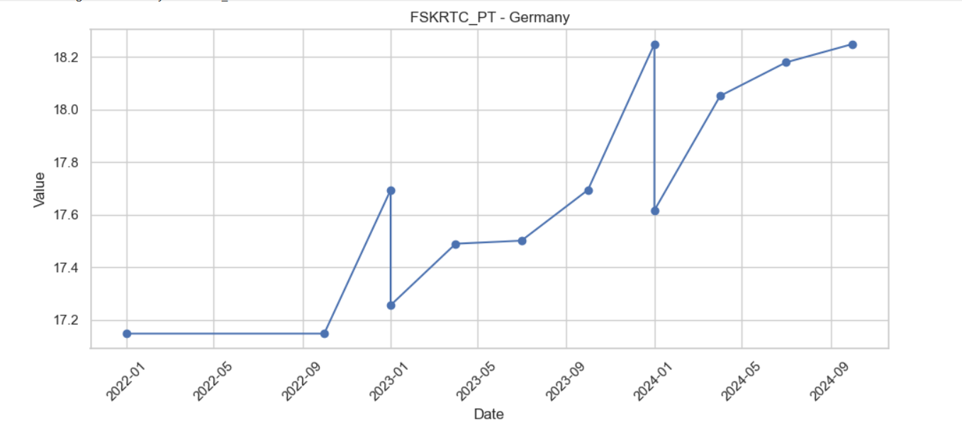
GERMANY –Tier 1 Capital Adequacy Trend (2022–2024)
Key Insights:
Tier 1 capital ratio remained flat around 17.18% during 2022, indicating stable core capital buffers.
From early 2023 onward, the ratio shows a consistent upward trend, crossing 18% by late 2024.
The increase reflects strengthened bank capital positions, possibly due to retained earnings, regulatory focus,
or reduced risk-weighted assets.
A higher Tier 1 ratio enhances banks' shock-absorption capacity, supporting financial system stability.
This trend signals a more resilient and well-capitalized banking sector amid evolving economic risks.

Slide 19
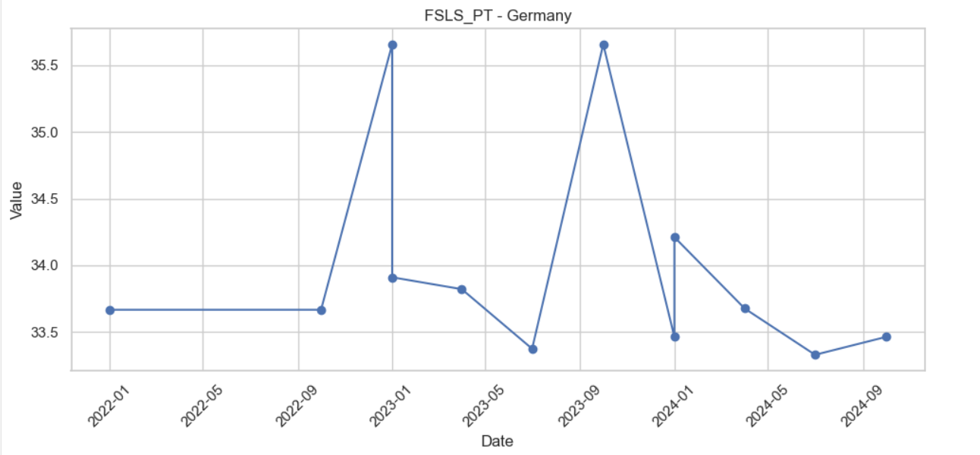
GERMANY – Liquidity Ratio Trend (2022–2024)
Key Insights:
Liquidity ratio stayed stable around 33.6% in 2022, reflecting a consistent buffer of high-quality liquid assets.
Spikes in early 2023 and late 2023 above 35.5% suggest temporary liquidity strengthening, possibly due to regulatory requirements or precautionary measures.
The ratio declined gradually through 2024, dropping below 34%, pointing to reduced short-term liquid asset coverage.
Volatility indicates fluctuating funding or asset management strategies amid changing market conditions.
Overall, while liquidity remains above regulatory thresholds, the recent downtrend may warrant closer monitoring to ensure continued resilience.

Slide 20
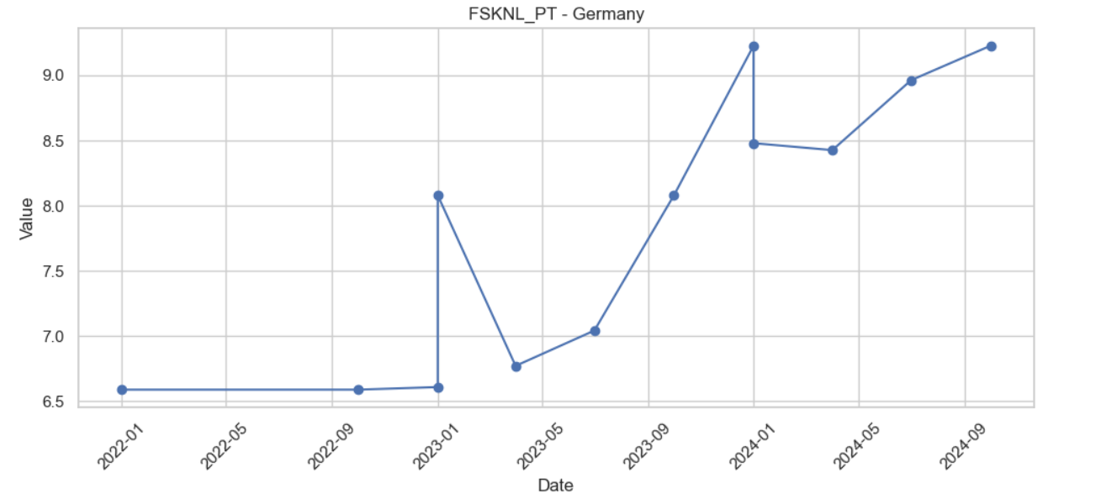
GERMANY – Non-performing Loans Net of Provisions to Capital(%) (2022–2024)
Key Insights:
From 2022 to early 2023, the ratio remained stable around 6.5%, indicating sufficient provisioning relative to NPLs.
A sharp spike in early 2023 followed by a dip suggests temporary under-provisioning or a sudden rise in NPLs.
Steady upward trend from mid-2023 to late 2024, reaching above 9%, indicates increasing unprovisioned credit risk relative to capital.
The rising ratio implies greater vulnerability of the banking sector, as more NPLs are left uncovered by provisions.
Sustained increase calls for tighter credit risk controls and stronger capital buffers to absorb potential losses.

Slide 21
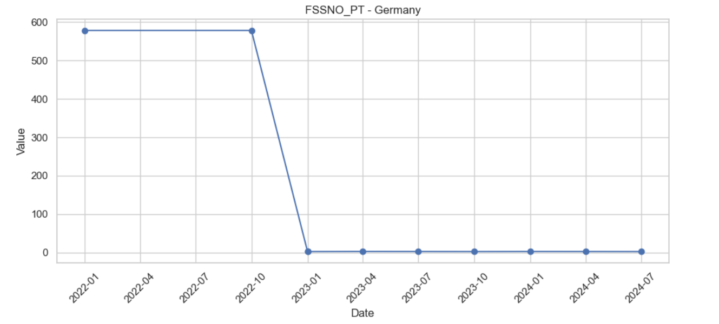
GERMANY Foreign Exchange Exposure to Capital (2022–2024)
Key Insights:
Extremely High Exposure in Early 2022: The FX exposure to capital stood at an unusually high level (~580%), indicating significant currency mismatch risk in the banking sector.
Sudden Drop to Zero by Early 2023: There was an abrupt and complete reduction in foreign exchange exposure after late 2022, suggesting a major regulatory shift, risk management decision, or data reporting change.
Flatlined at Zero Thereafter (2023–2024): The exposure remained at or near zero through 2023 and 2024, implying either:
Complete hedging or elimination of FX positions, or Change in accounting/reporting methodology.
Implication: This drastic change reflects a deliberate strategy to eliminate FX risk or a structural change in the financial sector. While this reduces currency risk, it could also suggest a loss of global diversification in portfolios.

Slide 22
Summary of Trends
Indicator | Trend Summary
Non-Performing Loans to Total Gross Loans (%) | Stable at ~1.24% in 2022; sharp rise in 2023; upward trend through 2024 (~1.75%), indicating gradual asset quality deterioration due to rising rates and repayment stress.
Return on Assets (ROA) | Solid rebound post-2020; remains above 0.6% through 2024, signaling resilient profitability despite macroeconomic pressures.
Tier 1 Capital Adequacy | Flat at ~17.18% in 2022; rises steadily to >18% by 2024, indicating improved capitalization and stronger bank shock-absorption capacity.
Liquidity Ratio | Stable ~33.6% in 2022; temporary spikes in 2023 (>35.5%) followed by a gradual decline in 2024, suggesting fluctuating liquidity strategies amid market shifts.
NPLs Net of Provisions to Capital (%) | Flat at ~6.5% in early 2023; rises to >9% by 2024, indicating increasing credit risk not fully covered by provisions—calls for improved risk controls.
FX Exposure to Capital | Extremely high in early 2022 (~580%); drops abruptly to 0% by 2023; flatlines through 2024. Suggests structural shift to eliminate FX risk, likely via hedging or reporting changes.

Slide 23
Overall Themes
Credit Risk Rising: NPLs and unprovisioned exposure both increasing—suggests pressure on borrower quality.
Capital & Profitability Strong: ROA and Tier 1 ratios improving, reflecting healthy margins and solid buffers.
Liquidity Volatile: Though still above regulatory minimums, short-term trends need monitoring.
FX Risk Eliminated: Major drop in currency mismatch—potentially at the cost of international diversification.

Slide 24

E Country-wise Analysis (Graphs + Insights) Country-wise Analysis (Graphs + Insights) Country-wise Analysis (Graphs + Insights) Country-wise Analysis (Graphs + Insights)
FRANCE

Slide 25
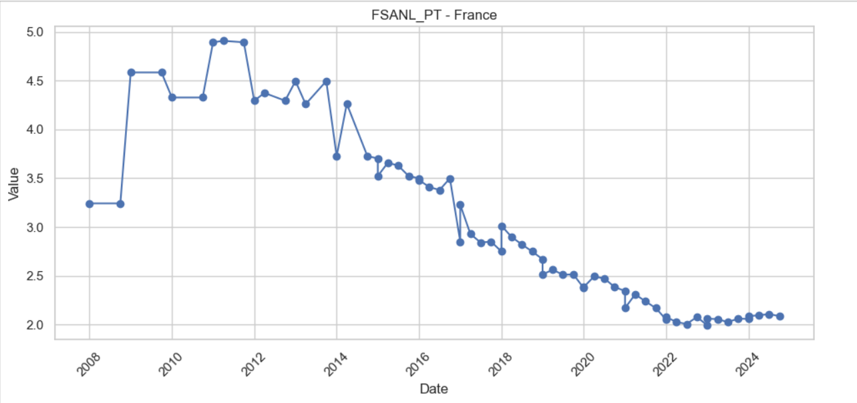
FRANCE – Non-performing Loans to Total Gross Loans (%) (2008–2024)
Key Insights :
Long-Term Downward Trend
The Non-Performing Loans (NPL) ratio in France has shown a consistent and significant decline from its peak near 5% in 2011 to just above 2% in 2024.
This indicates substantial improvements in credit quality and loan performance over the past decade.
High Stress Period: 2009–2013
Between 2009 and 2013, the NPL ratio remained persistently high (around 4.5%–5%), likely due to the aftershocks of the 2008 financial crisis and the European sovereign debt crisis.
Steady Improvement (2014–2020)
From 2014 onwards, the NPL ratio steadily declined from around 3.7% to 2.3% by 2020, reflecting improved risk management, economic recovery, and better underwriting practices by banks.
Stable and Low NPL Post-2021
Post-2021, the NPL ratio has stabilized between 2.0% and 2.1%, indicating a mature and resilient credit environment with minimal volatility.

Slide 26
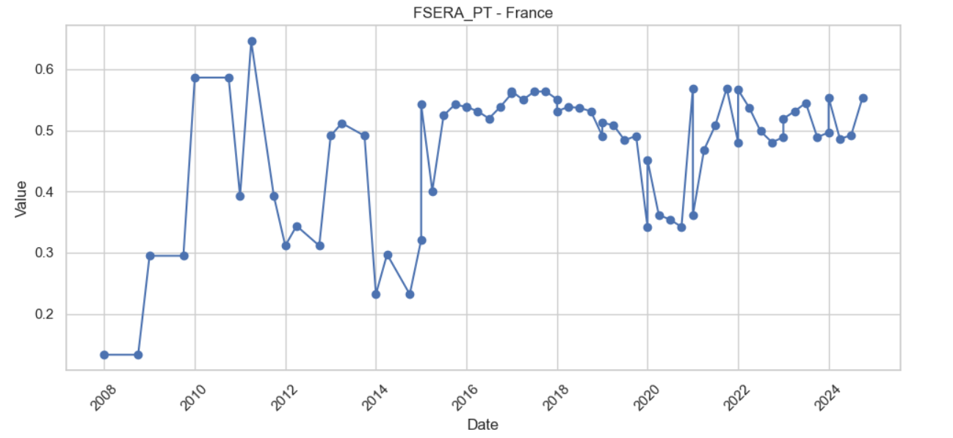
FRANCE – Return on Assets (ROA) (2008–2024)
Key Insights:
Sharp Recovery Post-2008: ROA improved significantly after the financial crisis, rising from ~0.14 in 2008 to ~0.58 by 2010, indicating strong early recovery in asset efficiency.
Volatile Period (2011–2014): The period saw major fluctuations, with ROA swinging between 0.3 and 0.65, reflecting economic uncertainty or sector-specific stress.
Stable Performance (2015–2019): ROA stabilized around ~0.5–0.55, suggesting improved risk management and consistent returns on assets.
COVID Dip & Recovery: ROA dipped in 2020 (~0.35), likely due to the pandemic, but rebounded strongly by 2022 and remained stable through 2024.
Implication: The recent steady ROA (~0.5) reflects a matured and resilient financial environment, though earlier volatility points to sensitivity to external shocks.

Slide 27
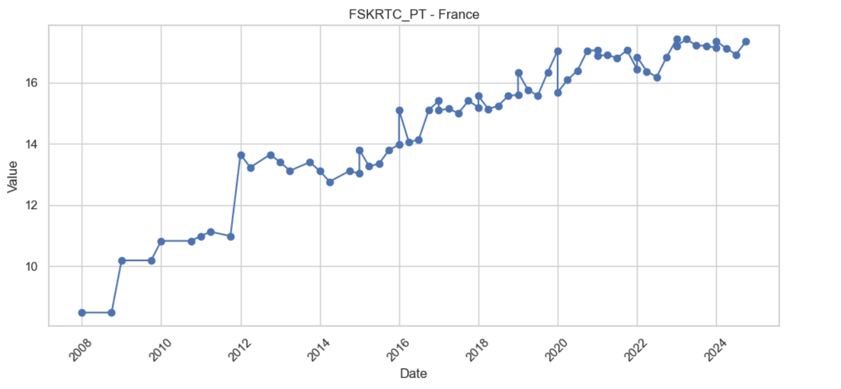
FRANCE –Tier 1 Capital Adequacy Trend (2008–2024)
Key Insights:
Gradual Strengthening Post-2008: Tier 1 capital ratios steadily increased from ~8.5% in 2008 to ~13.5% by 2012, reflecting regulatory reforms and recapitalization efforts post-crisis.
Stable Growth (2013–2019): Ratios remained relatively stable and trended upward (~13.5% to ~16%), indicating improved capital resilience across the French banking sector.
Pandemic-Era Boost (2020): A sharp rise in 2020 (~17.2%) suggests strengthened capital buffers in response to COVID-19-related risks.
Plateau with Minor Dips (2021–2024): The ratio largely stabilized around 16.5%–17%, with brief declines in 2022, pointing to a maturing capital framework and maintained regulatory compliance.
Implication: The consistent upward trend reflects stronger banking sector capitalization, enhancing shock absorption capacity and financial system stability.

Slide 28
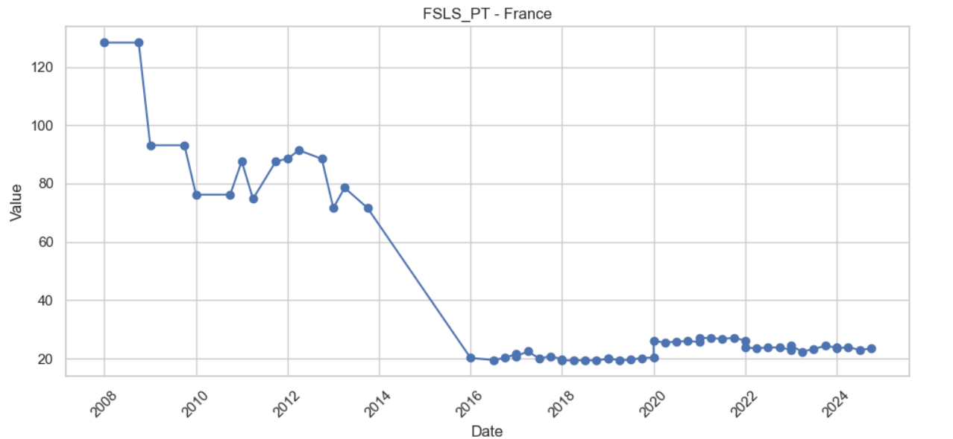
FRANCE – Liquidity Ratio Trend (2008–2024)
Key Insights:
Sharp Decline (2008–2016): Liquidity ratio dropped drastically from ~128 to ~20, indicating tightening liquidity conditions.
Stabilization Phase (2016–2024): Ratio remained relatively stable around 20–30, reflecting a prolonged low liquidity environment.
Short Recovery in 2020–2021: Slight uptick observed during this period, possibly linked to COVID-19 economic measures.
Overall Trend: From a high-liquidity regime pre-2010 to a new normal of low liquidity post-2016.

Slide 29
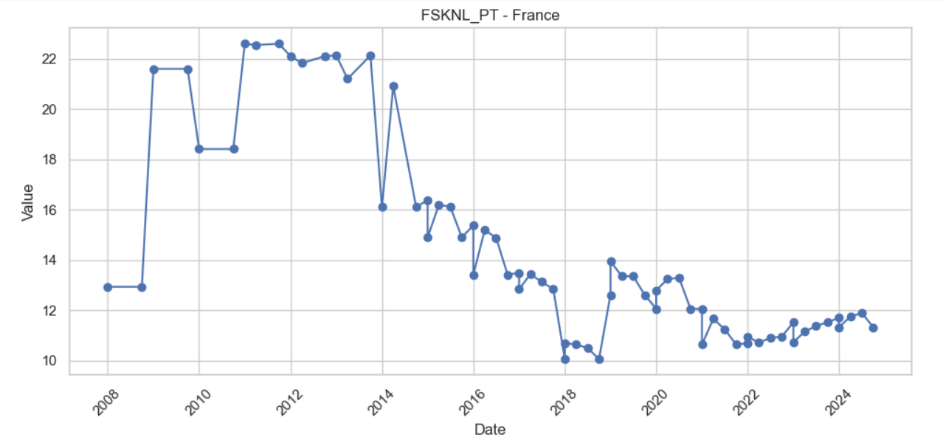
FRANCE – Non-performing Loans Net of Provisions to Capital (%) (2008–2024)
Key Insights:
Elevated NPLs (2009–2014): Ratio peaked above 22%, indicating heightened credit risk and pressure on capital buffers.
Consistent Decline Post-2014: Steady improvement with ratio falling to ~11% by 2024, reflecting stronger provisioning and asset quality.
Significant Drop (2017–2018): Marked decrease suggests better risk management or stronger capital position during this period.
Post-2018 Stability: Fluctuations between 10–13%, signaling relative stability in loan quality and provisioning levels.
Overall Trend: Clear downward trajectory, highlighting improved financial health of banks over time.

Slide 30
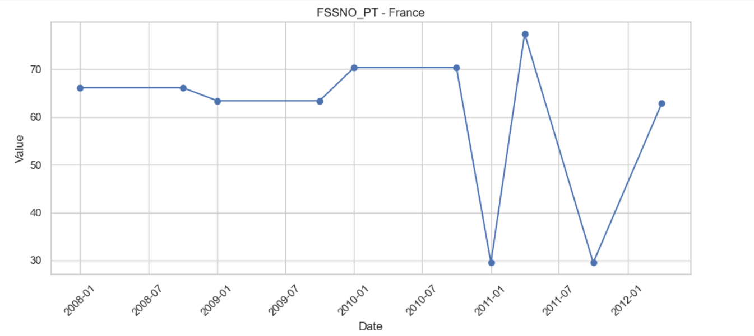
FRANCE Foreign Exchange Exposure to Capital (2008–2012)
Key Insights:
Stable Exposure (2008–2010): Maintained a relatively steady range of ~64–70%, suggesting consistent foreign exchange risk levels.
High Volatility (2011–2012): Sharp fluctuations observed — plummeting to ~30% in early 2011, peaking at ~76%, then dropping again.
Potential Risk Events: The extreme swings in 2011 may reflect market shocks or valuation changes impacting FX positions.
End of Period Recovery: Ratio rebounded to ~63% by 2012, returning near pre-2011 levels.
Overall Trend: Despite short-term volatility, the FX exposure ended the period at a level comparable to its starting point.

Slide 31
Summary of Trends
Indicator | Trend Summary
Non-Performing Loans to Total Gross Loans (%) | Peaked near 5% in 2011; steady decline to just above 2% by 2024. High stress observed during 2009–2013, followed by consistent improvement post-2014. Stabilized between 2.0–2.1% after 2021, indicating stronger credit quality and risk management.
Return on Assets (ROA) | Rose sharply post-2008 crisis, reaching ~0.58 by 2010. Volatile between 2011–2014, then stabilized around ~0.5–0.55 (2015–2019). COVID dip in 2020 (~0.35), followed by strong rebound—staying near ~0.5 through 2024, reflecting resilience and profitability.
Tier 1 Capital Adequacy | Increased from ~8.5% in 2008 to ~13.5% by 2012, rising steadily to ~17% by 2020. Post-2021, remained stable around 16.5–17% with minor dips—highlighting consistent capital strength and compliance with prudential norms.
Liquidity Ratio | Sharp decline from ~128 (2008) to ~20 by 2016, indicating post-crisis liquidity tightening. Stabilized around 20–30 from 2016 to 2024, with minor uptick during 2020–2021. Reflects a prolonged low-liquidity operating environment.

Slide 32
Summary of Trends (continue…)
Indicator | Trend Summary
NPLs Net of Provisions to Capital (%) | High levels (>22%) from 2009–2014 due to weak asset quality. Improved steadily post-2014; dropped to ~11% by 2024. Marked decline in 2017–2018 signals better provisioning and risk buffers. Fluctuated around 10–13% post-2018, indicating stability.
FX Exposure to Capital | Remained stable (~64–70%) until 2010; experienced extreme volatility in 2011–2012—dropping to ~30%, peaking at ~76%, and recovering to ~63% by 2012. Despite shocks, ended the period near initial levels, suggesting short-term risk without long-term deviation.

Slide 33
Overall Themes
Credit Risk Improving: NPLs have declined significantly since 2011, and net NPLs to capital are on a downward trajectory—signaling enhanced borrower quality and stronger provisioning practices.
Capital & Profitability Resilient: Consistently rising Tier 1 ratios and stable ROA (~0.5%) reflect robust capitalization, effective risk controls, and sustainable earnings performance.
Liquidity Stabilizing: After a sharp post-crisis contraction, liquidity ratios have remained in a narrow band since 2016, with temporary COVID-related relief—suggesting a new equilibrium.
FX Risk Contained: Despite past volatility (2008–2012), foreign exchange exposure returned to baseline, implying better hedging or localized risk strategies—though limited recent data caps full assessment

Slide 34

E Country-wise Analysis (Graphs + Insights) Country-wise Analysis (Graphs + Insights) Country-wise Analysis (Graphs + Insights) Country-wise Analysis (Graphs + Insights)
JAPAN

Slide 35
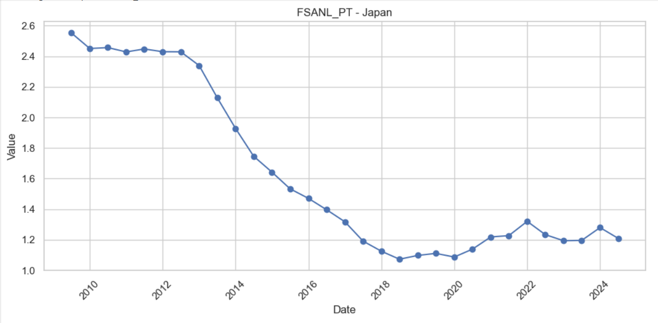
JAPAN – Non-performing Loans to Total Gross Loans (%) (2008–2024)
Key Insights :
Consistent Downward Trend (2008–2018): The NPL ratio steadily declined from ~2.55% to ~1.1%, reflecting improved asset quality and effective credit risk management.
Stabilization Phase (2018–2020): From 2018 onward, the ratio flattened around 1.1%–1.2%, suggesting a plateau in NPL reduction efforts.
Mild Uptick During 2021–2022: A slight increase (~1.3%) is visible around 2022—possibly due to economic disruptions (e.g., COVID-19 aftershocks).
Recent Stability (2022–2024): The ratio has hovered around 1.2%–1.3%, indicating resilience in the banking sector despite global uncertainties.
Overall Picture: Japan's banks have consistently improved loan quality over 15 years, with no sharp spikes, signaling sound financial health and strong regulatory oversight.

Slide 36
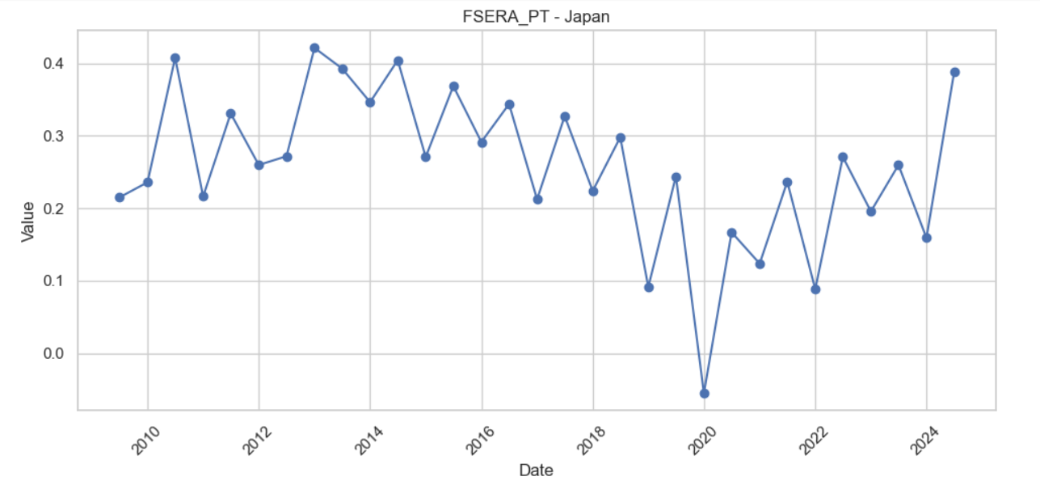
JAPAN – Return on Assets (ROA) (2008–2024)
Key Insights:
Stable Profitability (2008–2014): ROA remained within the 0.22%–0.42% range, indicating moderate and consistent profitability during this period.
Peaks in 2010 & 2013: The highest ROA values occurred in 2010 (~0.41%) and 2013 (~0.42%), showing periods of strong asset efficiency and performance.
Gradual Decline (2014–2019): A downward trend began in 2014, bottoming at ~0.09% in 2019, likely due to tightening margins or slower economic growth.
Sharp Drop and Recovery (2020): A significant dip below zero (~-0.03%) in 2020 reflects the impact of COVID-19 on banking profitability. However, a quick rebound followed, showing resilience.
Recent Improvement (2021–2024): ROA steadily improved, reaching ~0.39% in 2024, signaling a strong recovery and efficient asset utilization.

Slide 37
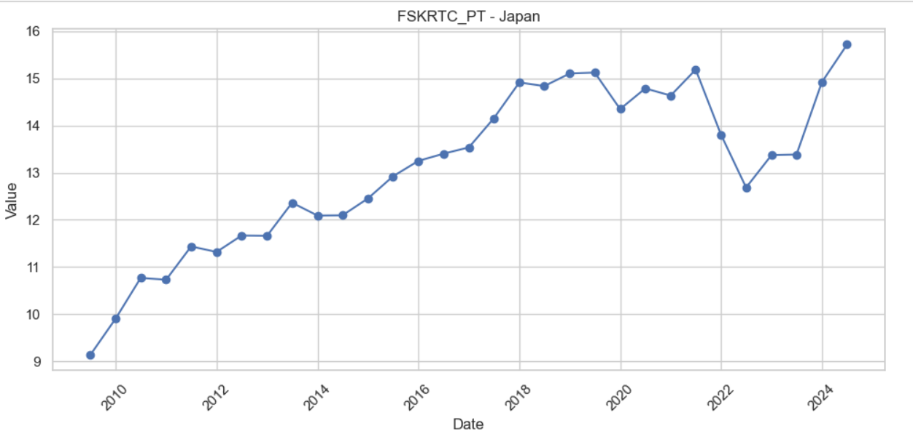
JAPAN –Tier 1 Capital Adequacy Trend (2008–2024)
Key Insights:
Steady Strengthening (2008–2018): The ratio improved consistently from ~9.1% in 2008 to ~14.9% by 2018, reflecting a solid buildup of core capital in response to regulatory reforms (e.g. Basel III).
Stabilization Phase (2018–2019): Capital adequacy remained stable at high levels (~15%), indicating a well-capitalized banking sector with strong shock-absorption capacity.
Temporary Decline (2020–2022): A drop from ~15% in 2020 to ~12.7% in 2022 likely due to:
COVID-19 related credit stress or provisioning.
Increased lending or risk-weighted assets.
Strong Rebound (2023–2024): The ratio rose sharply to ~15.8% by 2024, suggesting:
Capital infusions, reduced risk assets, or
Improved profitability aiding retained earnings.

Slide 38
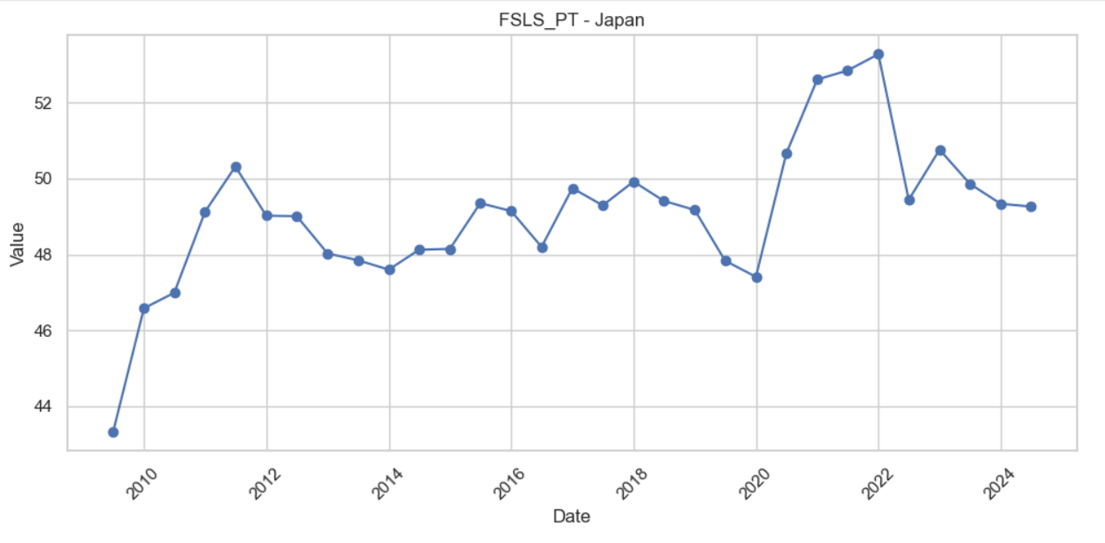
JAPAN – Liquidity Ratio Trend (2008–2024)
Key Insights:
Early Growth Phase (2008–2011): The liquidity ratio increased significantly from ~43.3% in 2008 to ~50.3% in 2011, likely reflecting post-crisis prudence and efforts to bolster liquid assets.
Plateau & Minor Fluctuations (2012–2019): Between 2012 and 2019, the ratio fluctuated within a narrow range of ~47.5% to ~49.9%, showing overall stability but no major liquidity strengthening.
Pandemic-Driven Spike (2020–2022): A sharp rise from ~47.5% in 2019 to a peak of ~52.9% in 2022, likely driven by:
Liquidity hoarding during COVID-19
Regulatory buffers and risk aversion in uncertain economic conditions
Recent Decline (2023–2024): The ratio declined moderately to ~49.1% by 2024, indicating a normalization of liquidity buffers as economic conditions stabilized post-pandemic.

Slide 39
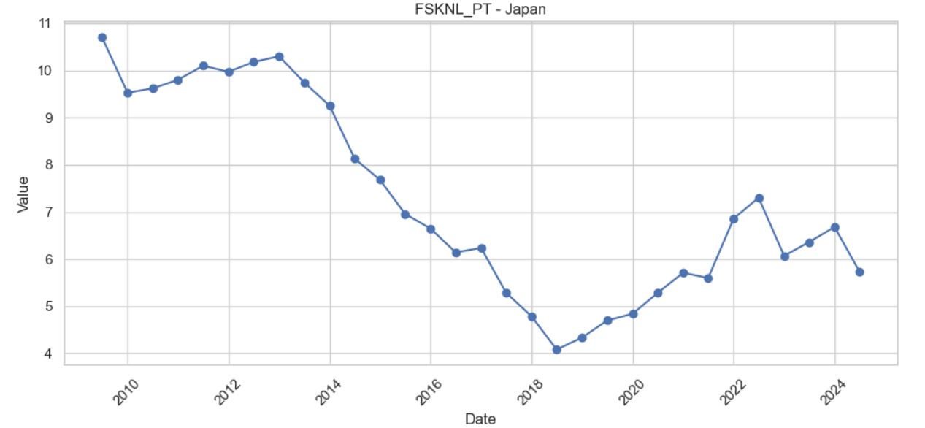
JAPAN – Non-performing Loans Net of Provisions to Capital (%) (2008–2024)
Key Insights:
High NPL Burden (2008–2013): From ~10.7% in 2008, the ratio stayed relatively high until 2013, fluctuating between ~9.5% and 10.3%. This reflects a considerable capital strain from impaired loans post-global financial crisis.
Steady Improvement (2013–2018): A clear downward trend from ~9.6% in 2013 to a low of ~4.1% in 2018, indicating:
Effective provisioning practices
Better asset quality and loan recovery efforts
Pandemic Impact and Partial Reversal (2019–2022): NPLs crept up from ~4.6% in 2019 to ~7.3% in 2022, likely due to:
COVID-19 related credit stress
Deteriorating borrower performance during economic slowdown
Recent Stabilization (2023–2024): After peaking in 2022, the ratio improved slightly to ~5.8% in 2024, reflecting:
Recovery in asset quality
Stabilized capital buffers

Slide 40
Summary of Trends
Indicator | Trend Summary
Non-Performing Loans to Total Gross Loans (%) | Steady decline from ~2.55% (2008) to ~1.1% (2018) due to improved asset quality and risk management; stabilized at ~1.2%–1.3% from 2018 onward, with minor uptick in 2022 (COVID-19 aftershocks); remains stable through 2024, indicating sectoral resilience.
Return on Assets (ROA) | Moderate and stable profitability (0.22%–0.42%) from 2008–2014; peaks in 2010 and 2013; declined sharply to ~0.09% by 2019; brief drop below zero in 2020 (COVID-19 impact); strong recovery to ~0.39% by 2024 reflects improved efficiency
Tier 1 Capital Adequacy | Consistent growth from ~9.1% (2008) to ~14.9% (2018); plateaued in 2019; fell to ~12.7% during 2020–2022 likely due to credit stress; rebounded to ~15.8% by 2024, showing renewed capital strength and stability.
Liquidity Ratio | Rose from ~43.3% (2008) to ~50.3% (2011); remained stable (47.5%–49.9%) during 2012–2019; spiked to ~52.9% in 2022 (COVID-driven); declined slightly to ~49.1% by 2024, indicating normalization of liquidity buffers.

Slide 41
Summary of Trends (continue…)
Indicator | Trend Summary
NPLs Net of Provisions to Capital (%) | High burden (9.5%–10.7%) during 2008–2013; steadily declined to ~4.1% by 2018 due to provisioning improvements; rose again to ~7.3% in 2022 (pandemic impact); eased to ~5.8% in 2024, indicating partial risk recovery.

Slide 42
Overall Themes
Credit Quality Strengthened: Long-term NPL reduction and stable recent levels show Japan's effective credit risk management—pandemic disruptions were contained without systemic spikes.
Profitability Resilient: ROA shows a clear recovery after 2020’s dip, supported by efficient operations and a favorable macro rebound—returning close to pre-2014 highs.
Capital Base Solidified: Tier 1 ratios rebounded strongly post-2022, confirming the banking sector’s enhanced ability to absorb shocks and meet evolving regulatory demands.
Liquidity Well-Managed: Post-COVID liquidity build-up is being cautiously unwound, pointing to confidence in market conditions and prudent liquidity strategy.
Provisioning Frameworks Effective: Though stress emerged in 2020–22, improved NPL provisioning since 2013 has helped mitigate capital erosion—stabilization suggests proactive risk controls.

Slide 43

Conclusion & Recommendations
This analysis of Financial Soundness Indicators (FSIs) across Brazil, Germany, France, and Japan offers a comprehensive view of key banking sector risks:
Asset Quality: Brazil exhibited higher credit risk (NPLs), while advanced economies maintained healthier loan books.
Profitability: Global profitability declined post-COVID, but some recovery is seen in Europe.
Capital Adequacy: All countries met regulatory minimums, though Brazil showed greater variability.
Liquidity: Most countries demonstrated strong liquidity buffers, especially during crisis years.
Market Risk Exposure: FX sensitivity increased in emerging markets like Brazil, indicating the need for stronger hedging or capital buffers.

Slide 44
Conclusion & Recommendations
Recommendations
Regulatory Focus: Emerging economies should prioritize improving capital buffers and provisioning strategies to withstand credit stress.
Stress Testing & Forecasting: Institutions should adopt regular scenario-based stress testing using FSI metrics to identify vulnerabilities early.
Data Transparency: Encourage broader and more timely reporting of FSIs, especially for liquidity and FX exposure to support cross-border comparisons.

Slide 45
Final tips & takeaways
Regulatory indicators are more than just numbers. They are early warning signals. Understanding them isn’t just for compliance, it’s essential for building resilient financial systems.
Takeaway for Analysts & Stakeholders:
Mastering the interpretation of financial soundness data enables proactive decision-making, informed risk management, and strategic foresight in today’s dynamic financial landscape.

Slide 46
Thank you
Amal S
+91 8792012304
amal17ek@gmail.com

